Slide 1

TEAM AETHERIX
Scholarship Advisor
Console System — Python Project
Team Lead : Rathi Sankari S
Members : Yogapriya | Yogeshwari | Rajeshwari
Dept: AI & DS | J.J. College of Engineering & Technology, Tiruchirappalli
Python 3.x
OOPs
CSV
Auth
DSA

Slide 2



02
Abstraction
Abstraction in the Scholarship Advisor hides all internal matching complexity from the student. The student simply enters their profile — the system internally runs 6 eligibility checks, sorts results, calculates combine amounts, and saves reports — without exposing any of that logic to the user. Each module is a black box with a clean interface.
User sees
Hidden inside
Output only
Menu options 1–4. Enter name, marks, income. View results. That is all.
6 eligibility checks · linear search · sort algorithm · combine logic · SHA-256 auth · file I/O
Ranked scholarships, amounts, deadlines, document checklist, status tracker, report file.
Encapsulation
Abstraction
Inheritance
Polymorphism
Profile data + methods in StudentProfile class
Internal logic hidden; only clean API exposed
Base Validator class extended by InputValidator
display() behaves differently per scholarship type

Slide 3
03
Existing vs Proposed Solution
❌ Existing Approach
✅ Proposed Solution
✗ Student manually visits 10+ government websites
✓ Single console app covers Govt + Private + NGO
✗ No single place for Govt + Private + NGO schemes
✓ 19 scholarships, 14 input fields, 6-criteria match
✗ Eligibility is guessed — no systematic check
✓ Systematic eligibility check — no guesswork
✗ Deadlines missed — no alerts or calendar
✓ Deadline alerts and scholarship calendar built-in
→
✗ No document checklist — students unprepared
✓ Master document checklist generated automatically
✗ No application status tracking in one place
✓ Status tracker: Applied → Under Review → Approved
✗ Requires internet — rural students excluded
✓ Fully offline — works without internet connection
✗ No guidance for Class 12 freshers entering college
✓ Special Class 12 fresher mode with urgent alerts

Slide 4




04
System Design
The system follows a 4-layer modular design. Each layer is owned by one team member and communicates with adjacent layers through well-defined function interfaces. No layer accesses another layer's data directly — all data passes via return values.
Layer 1
UI Module
Layer 2
Database Module
Layer 3
Engine Module
Layer 4
Reports Module
member1_ui.py
member2_database.py
member3_engine.py
member4_reports.py
Menu · Input
Validation · Display
CSV Load
App Guide · Validate
Eligibility
Sort · Combine
Status · Report
History · Files
main.py — Entry point. Imports all 4 modules. Runs while True loop. Connects all layers.
auth.py — SHA-256 password hashing · User registration · Login with 3-attempt lockout

Slide 5
05
Software Requirements
Functional Requirements
Non-Functional Requirements
01. Collect 14 student input fields with validation
06. Combine checker — max possible amount
Performance: Results in under 2 seconds for any profile
02. Load 19 scholarships from scholarships.csv
07. Show official website, apply steps, documents
Offline: Works fully without internet connection
03. Run 6-criteria eligibility match per scholarship
08. Manual status tracker saved to tracker.txt
Usability: Number-key navigation — no mouse needed
04. Sort matched results by amount (descending)
09. Generate report as report_name_date.txt
Portability: Runs on Windows, Mac, Linux with Python 3.x
05. Show Govt / Private / NGO groups separately
10. User login & registration with SHA-256 hash
Error Handling: try-except on every input and file operation
Scalability: New scholarships added by editing CSV only
Security: Passwords hashed with SHA-256 hashlib
Maintainability: 4 separate .py files — independently editable
Tech Stack: Python 3.x | csv | os | hashlib | logging | datetime | json | collections — No external libraries required

Slide 6
06
Sample Code
StudentProfile Class (OOP — Encapsulation)
check_eligibility() — Linear Search O(n)
auth.py — SHA-256 Login (Authentication)
class
def check_eligibility(profile: dict, scholarships: list) -> list:
import hashlib
StudentProfile
matched = [] # DSA: List
def hash_password(password: str) -> str:
:
for scholarship in scholarships: # O(n) linear search
return hashlib.sha256(password.encode()).hexdigest()
def __init__(self):
if profile['percentage'] < float(scholarship['MinMarks']):
def login_user() -> str:
self.name = '' ; self.percentage = 0.0 ; self.category = ''
continue # skip — marks too low
for attempt in range(3): # max 3 login attempts
self.father_income = 0 ; self.mother_income = 0
if profile['total_income'] > int(scholarship['MaxIncome']):
if check_credentials(username, hash_password(password)):
@property
continue # skip — income too high
return username # ✅ login success
def total_income(self): return self.father_income + self.mother_income
matched.append(scholarship)
return None # ❌ locked out after 3 fails
OOPs
Collections
Exception Handle
File Handling
DSA
Class, Object, Property, Encapsulation
list, dict, set, frozenset, Counter
try-except ValueError, FileNotFoundError
CSV read, txt write/append, JSON auth
Linear O(n), sorted() O(n log n), frozenset

Slide 7
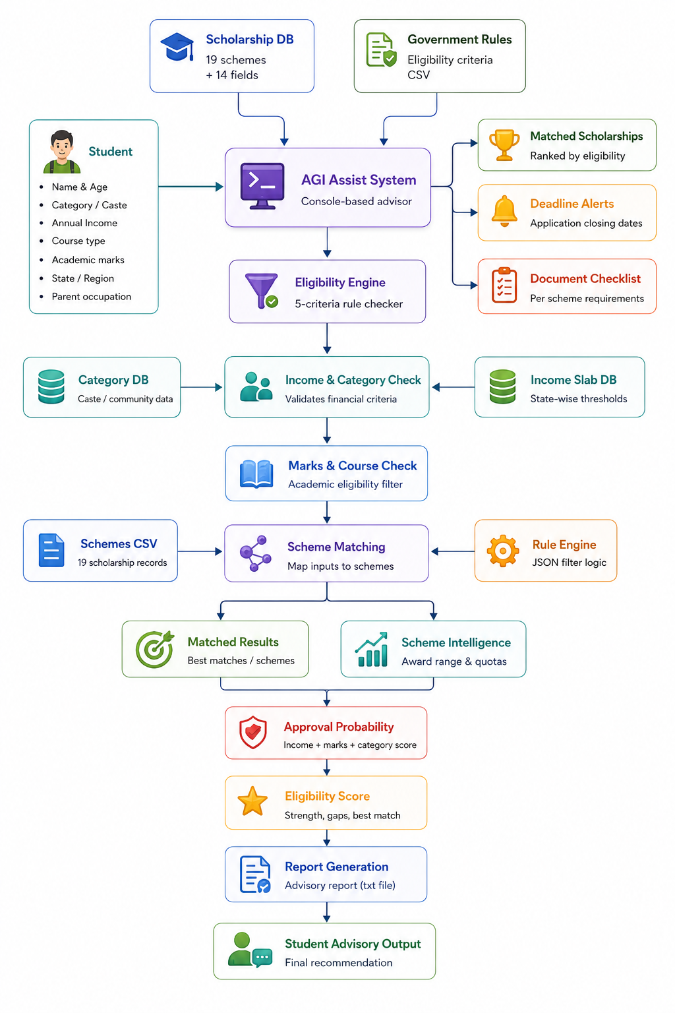
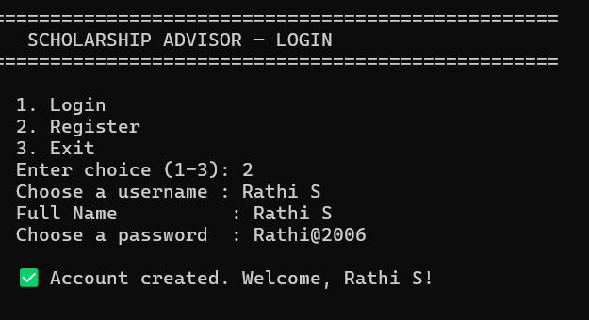
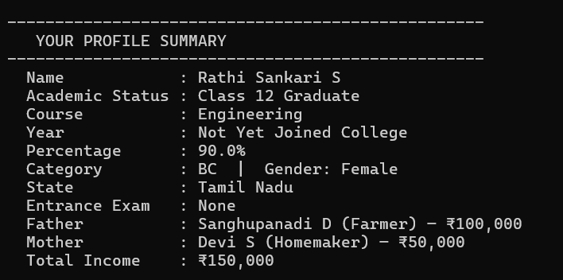
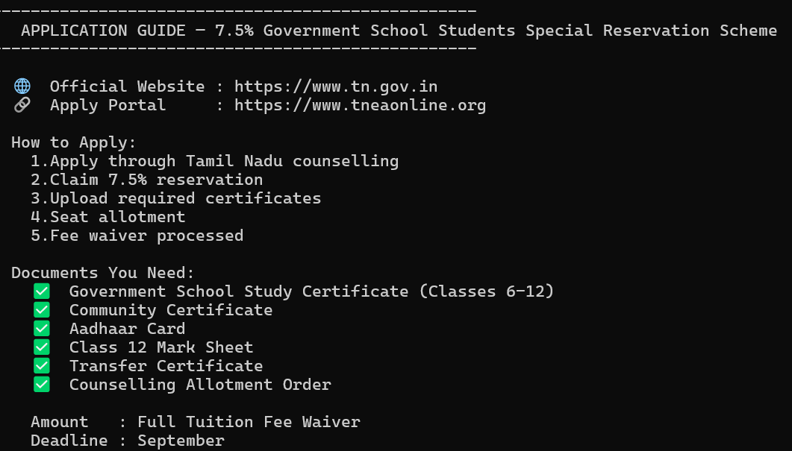

Slide 8






07
Outcome
The Scholarship Advisor produces a complete, ranked, personalised scholarship result in under 2 seconds — covering Government, Private, and NGO schemes — with application guidance, documents checklist, combine analysis, and status tracking. The following outcomes are achieved from a single console session:
19
14
6
4
3
Scholarships
matched & ranked
Student inputs
collected & validated
Eligibility criteria
checked per scheme
Python modules
fully integrated
Types: Govt
Private · NGO
Ranked Scholarship List
Application Guide
Combine Report
All eligible schemes sorted by amount — highest first. Govt, Private, NGO shown in separate groups.
For each scheme: official website, step-by-step apply process, and full documents checklist.
Which scholarships can be applied simultaneously and total maximum possible funding calculated.
Status Tracker
Student Report File
Search History
Student updates Applied → Under Review → Approved. All statuses saved to tracker.txt locally.
Full report saved as report_name_date.txt including profile, results, and document checklist.
Every session appended to history.csv — viewable in reverse chronological order from the main menu.

Slide 9






08
Conclusion & Future Scope
The Scholarship Advisor Console Application successfully demonstrates a complete, real-world Python project that solves a genuine student problem. It applies all required academic concepts — OOPs, Collections, DSA, File Handling, and Exception Handling — while delivering tangible social value to first-generation, rural, and low-income students across Tamil Nadu and India.
Social Impact
Academic Coverage
Technical Depth
First-gen and rural students can now discover schemes they would otherwise miss entirely
OOPs · Collections · DSA · File I/O · Exception Handling · Authentication all demonstrated
SHA-256 auth · linear O(n) search · sorted() O(n log n) · frozenset O(1) · CSV + JSON I/O
Future Scope
Web Application
AI Recommendations
NSP API Integration
School Students
Flask/Django frontend — browser access from any device
ML model for personalised matching based on student history
Auto-fetch application status + SMS/email deadline reminders via Twilio
Expand to Class 8-12 with pre-matric scholarship database

Slide 10

Thank You!
Scholarship Advisor Console Application — Team Aetherix
Team Lead : Rathi Sankari S
Dept: AI & DS | J.J. College of Engineering & Technology, Tiruchirappalli
Python 3.x
OOPs
DSA
Auth
CSV
Offline

